Slide 1
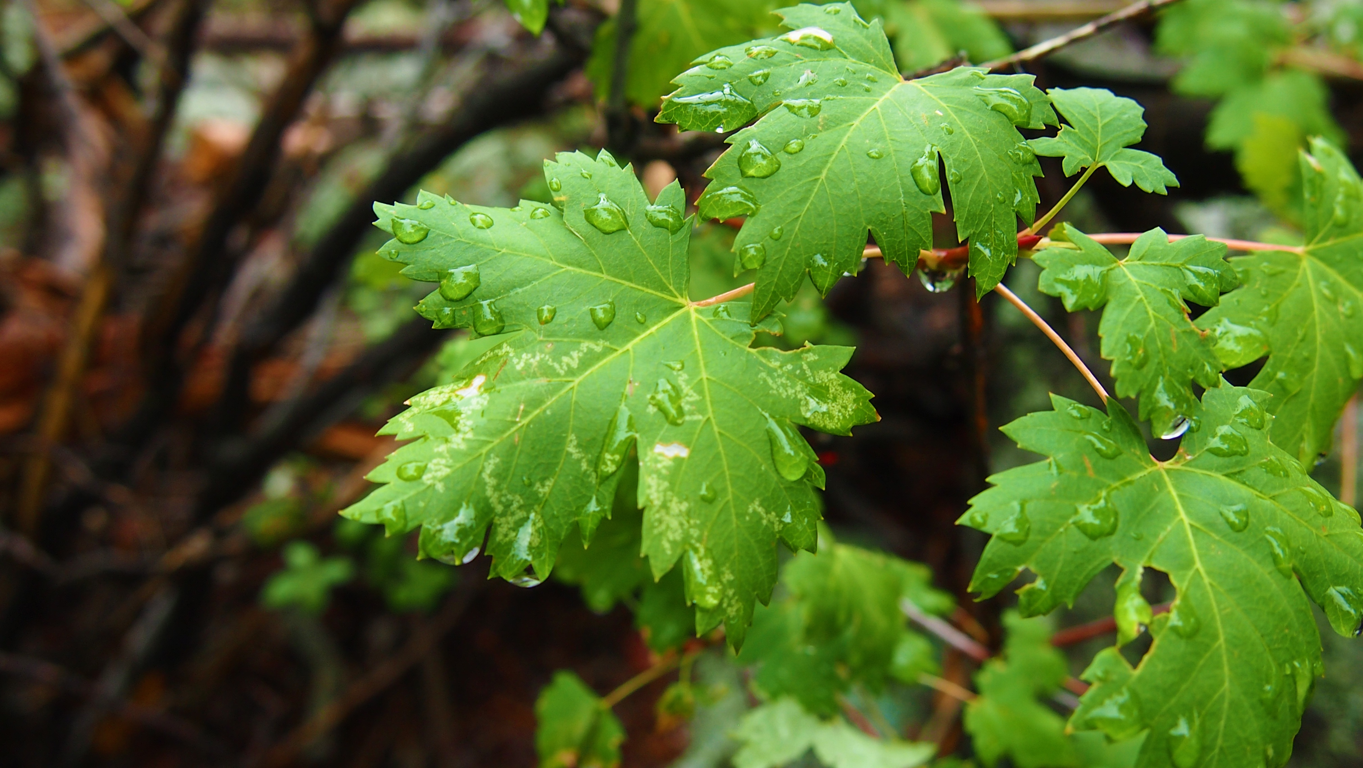
Plant Disease Classification
Plant Disease Detection

Slide 2

Outline
Abstract
Problem Statement
Objectives and Constraints
About the Dataset
Technical Stack
Data Preprocessing
Training and Testing Algorithm
Applications
References

Slide 3
Abstract
In the project, we used Deep learning models to detect plant diseases in the agriculture sector.
With some training samples from the two groups, the automatic classifier CNN will be employed for this method of categorization.
These models are used to predict diseases from the images that are given by user or farmers.
This project aims to develop an optimal and more accurate method for detecting diseases of plants by analyzing leaf images.

Slide 4
Problem Statement
Early detection and accurate diagnosis of plant diseases are crucial for effective disease management and prevention.
This project aims to develop a plant disease detection system using deep learning techniques to help farmers and agricultural experts quickly and accurately identify plant diseases and take necessary actions to control them.

Slide 5
Objectives and Constraints
Objectives:
To identify the relationships between the disease-causing organisms and their host plants in relation to the ecosystem as a whole.
To put into practice a technique for illness prevention and offering management for lowering the losses/damages brought on by diseases.
to recognize numerous plant diseases.
Constraints:
To detect disease from a large dataset or multiple plant species.

Slide 6
About Dataset
The dataset collected from open source website “kaggle”.
The dataset contains 87k image samples of 14 crops.
The dataset consists of 38 classes corresponding to 38 leaf diseases of 14 crops.
The 38 classes are listed below:
Tomato___Late_blight | 'Tomato___healthy', | 'Grape___healthy', | 'Orange___Haunglongbing_(Citrus_greening)', | 'Soybean___healthy', | 'Squash___Powdery_mildew', | 'Potato___healthy', | 'Corn_(maize)___Northern_Leaf_Blight', | 'Tomato___Early_blight', | 'Tomato___Septoria_leaf_spot',
'Corn_(maize)___Cercospora_leaf_spot Gray_leaf_spot', | 'Strawberry___Leaf_scorch', | 'Peach___healthy', | 'Apple___Apple_scab', | 'Tomato___Tomato_Yellow_Leaf_Curl_Virus' | 'Tomato___Bacterial_spot', | 'Apple___Black_rot', | 'Blueberry___healthy', | 'Cherry_(including_sour)___Powdery_mildew', | 'Peach___Bacterial_spot',
, 'Apple___Cedar_apple_rust', | 'Tomato___Target_Spot', | 'Pepper,_bell___healthy', | 'Grape___Leaf_blight_(Isariopsis_Leaf_Spot)', | 'Potato___Late_blight', | 'Tomato___Tomato_mosaic_virus', | 'Strawberry___healthy', | 'Apple___healthy', | 'Grape___Black_rot', | 'Potato___Early_blight',
'Cherry_(including_sour)___healthy', | 'Corn_(maize)___Common_rust_', | 'Grape___Esca_(Black_Measles)', | 'Raspberry___healthy', | 'Tomato___Leaf_Mold', | 'Tomato___Spider_mites Two-spotted_spider_mite', | 'Pepper,_bell___Bacterial_spot', | 'Corn_(maize)___healthy

Slide 7
Technical Stack
TensorFlow
Pickle
OpenCV
Pandas
Matplotlib
Transfer learning
CNN
Stream lit

Slide 8
Data Preprocessing
Image processing :
It is a method to perform some operations on an image, in order to get some useful information from it.
Steps involved in image processing are:
Image Acquisition
Image Enhancement
Image Restoration
Color Image Processing
Image Segmentation

Slide 9
Image Acquisition
Image acquisition is the first step in image processing.
It involves retrieving the image from a hardware-based source.
OpenCV gives the flexibility to capture image directly from a pre-recorded video stream, camera input feed, or a directory path.
Example:
img = cv2.imread('/content/new plant diseases dataset(augmented)/data/train/Apple___Apple_scab/00075aa8-d81a-4184-8541-b692b78d398a___FREC_Scab 3335.JPG')

Slide 10
Image Enhancement
Image enhancement is the process of adjusting digital images so that the results are more suitable for display or further image analysis.
For example, you can remove noise, sharpen or brighten an image, making it easier to identify key features.
final_mask = mask + disease_mask
final_result = cv2.bitwise_and(img, img, mask=final_mask)
plt.figure(figsize=(10,10))
plt.subplot(1, 2, 1)
plt.imshow(final_mask, cmap="gray")
plt.subplot(1, 2, 2)
plt.imshow(final_result)
plt.show()

Slide 11
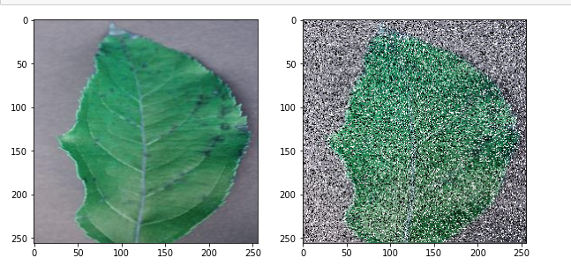
Image Restoration
Image restoration is the process of recovering an image from degraded version – usually a blurred and noisy image.

Slide 12
Colour Image processing
In colour image processing, colour space uses a three-dimensional coordinate system. RGB is the default colour space.
# lets change the color from BGR to RGB
img = cv2.imread('/content/new plant diseases dataset(augmented)/data/train/Apple___healthy/03d420e7-42a1-41d8-9600-16d577043c64___RS_HL 5738.JPG')
plt.subplot(1,2,1)
plt.imshow(img)
plt.subplot(1, 2, 2)
img = cv2.cvtColor(img, cv2.COLOR_BGR2RGB)
plt.imshow(img)
plt.show()
hsv_img = cv2.cvtColor(img, cv2.COLOR_RGB2HSV)
gray_image = cv2.cvtColor(img,cv2.COLOR_BGR2GRAY)
sketch_image=cv2.divide(gray_image,inverted_image, scale=256.0)
pencil_sketch=cv2.cvtColor(sketch_image, cv2.COLOR_BGR2RGB)

Slide 13
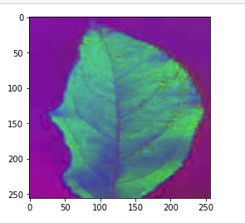
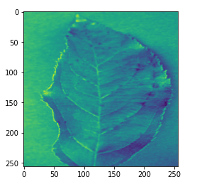
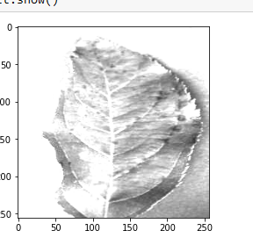
RGB2GRAY:
RGB2HSV:
RBG2SKETCH

Slide 14
Image Segmentation
Image segmentation helps in reducing the complexity of the image to make further processing or analysis of the image simpler.
Types of Image Segmentation:
Image Segmentation using edge detection
Image Segmentation using K means
Image Segmentation using Contour Detection
Image Segmentation using Color Masking

Slide 15
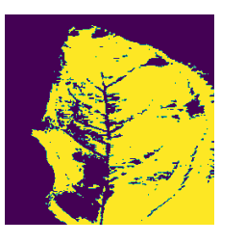
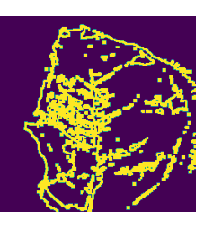
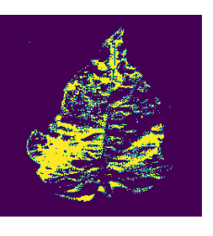
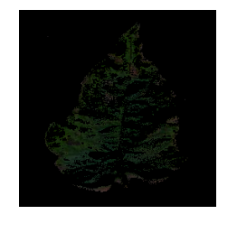

Slide 16
Training and Testing Algorithm
Step 1: Start
Step 2: Prepare Dataset (healthy/Unhealthy)
Step 3: Preprocessing – Normalization ( size of 64 * 64 )
Step 4: Train CNN
Step 5: Real Image from camera/pc
Step 6: Preprocessing (size = 64*64)
Step 7: Test Network

Slide 17
Step 8: if the probability of healthy > probability of unhealthy
Display Healthy Image
otherwise Display an Unhealthy image
Step 9: Go to Step 4
Step 10: End

Slide 18
Applications
Image Recognition:-. Image rearrangement in a machine-learning environment Software's capacity to recognize things, locations, people, text, and actions in images is known as machine vision.
Classification: It offers a precision of roughly 93% for the accurate and automatic diagnosis of leaf diseases.
Prediction:- The camera and app that make expert forecasts.
Extraction:- Techniques for extracting medicinal herbs The separation of the plant's medicinally effective parts is referred to as extraction.
Prediction of plant diseases and advice on fertilization

Slide 19
Summary
Described a deep convolutional neural network model to identify plant foliar diseases.
80,000+ photos were used for training and validation.
shown that the model can be used to predict a wide range of plant disease types..
The suggested method might be adopted in the future by including more services like neighboring public stores and a pesticide price list. open market nearby, among other things.
Also, the suggested system might be accessible via an application.
The given system uses resizing, thresholding, and Gaussian filtering for image preprocessing to segment the leaf area.
Then finally CNN classification technique is used to detect the type of plant disease.

Slide 20
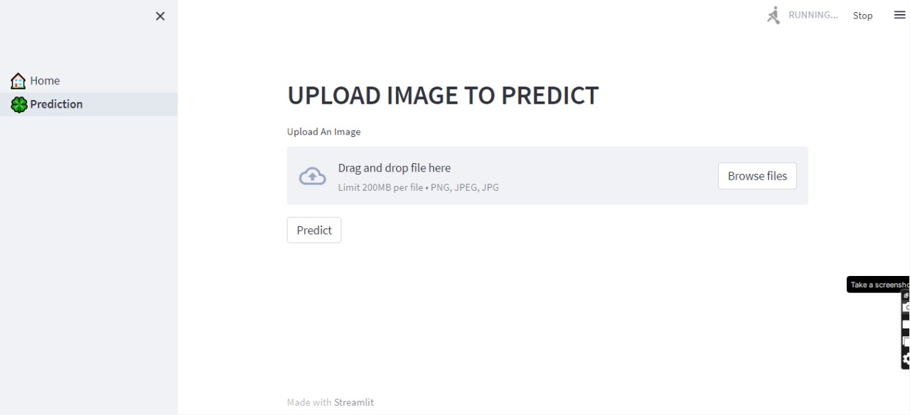
USER INTERFACE
Step 1: User will upload a Image.
Step 2: The CNN model will analyze the image and will classify the image into healthy or unhealthy category along with its disease name.

Slide 21
Future Scope
As disease forecasting is done at early stage, then the necessary precautions can be taken to prevent crop loss.
Our model can detect the disease as soon as it start spreading on leaf.
Developing and training a CNN model from scratch is a difficult task. This model can also be used to detect and classify other plant diseases by simply training it with the appropriate datasets.

Slide 22
References
https://www.kaggle.com/
https://www.analyticsvidhya.com/
https://towardsdatascience.com/
https://www.geeksforgeeks.org/
https://www.tensorflow.org/
https://keras.io/
https://docs.streamlit.io/

Slide 23
Thank you
TEAM MEMBERS
VARUN PATIL
BHARATH KUMAR M.S
DEEKSHA REDDY
LAKSHMI PRATHYUSHA

